Slide 1

Credit Risk Management

Slide 2

Gerend Christopher

Slide 3


Why Credit Risk Management Matters?
Mitigating risks
Reducing occurrences of fraud

Slide 4
Data
The dataset has 32581 entries and 12 columns
Variable Name | Data Type | Details
person_age | Numeric (Integer) | Age (20 – 144 years old)
person_income | Numeric (Float) | Annual Income (4,000 – 2,039,784)
person_home_ownership | Categorical | Home Ownership (Own, Rent, Mortgage, Other)
person_emp_length | Numeric (Float) | Employment Length (0 – 38 years)
loan_intent | Categorical | Loan Intention (Education, Medical, Venture, Personal, Debt Consolidation, Home Improvement)
loan_grade | Categorical | Loan Grade (Grade A to Grade G)
loan_amnt | Numeric (Integer) | Loan Amount (500 – 35,000)
loan_int_rate | Numeric (Float) | Interest Rate (5.42 - 23.22)
loan_status | Numeric (Integer) | Status (0: non default, 1: default)
loan_percent_income | Numeric (Float) | Percent Income (0 – 0.83)
cb_person_default_on_file | Categorical | Historical Default (Yes or No)
cb_person_cred_hist_length | Numeric (Integer) | Credit History Length (2 – 30)
Default is the failure to repay a loan

Slide 5
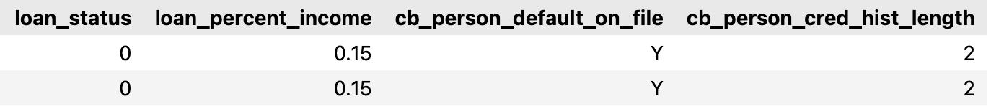
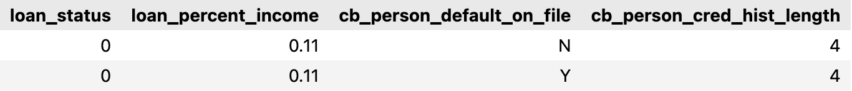
Data Cleaning
Duplication
There are 165 duplicate data. We drop the duplications.
There are duplicate data which have different historical default. We keep it since there is no ID or time

Slide 6
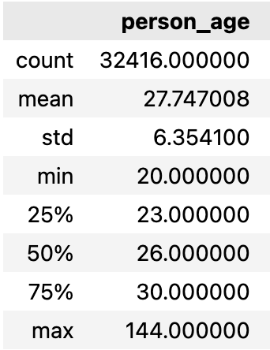
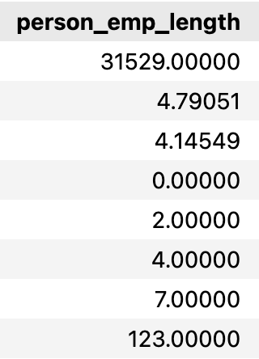
Data Cleaning
Anomaly
It’s very unlikely for very old person to apply credit and receive it.
We set boundary to analyze application below 75 years old.
Persons who have 123 years employment are 21 and 22 years old!
We set it to nan first

Slide 7
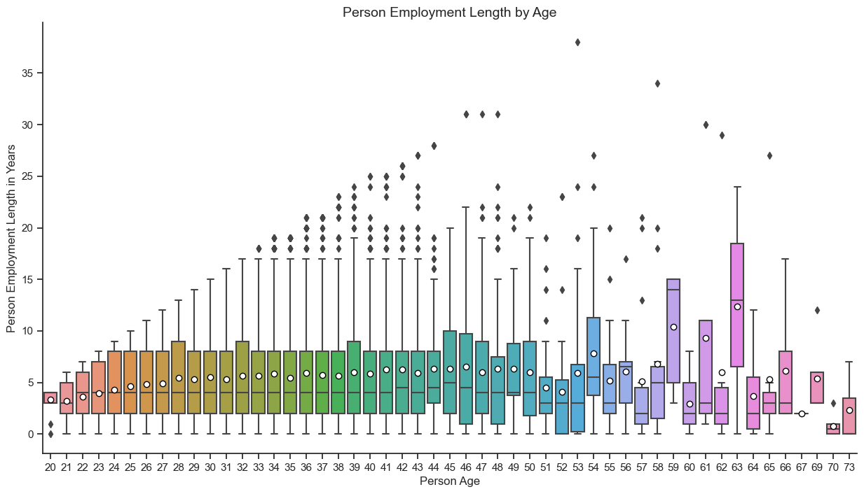
Data Cleaning
Null Values
Variable Name | Total Null
person_emp_length | 889
It’s more likely to have similar years experience around the same age
We impute with the median.

Slide 8
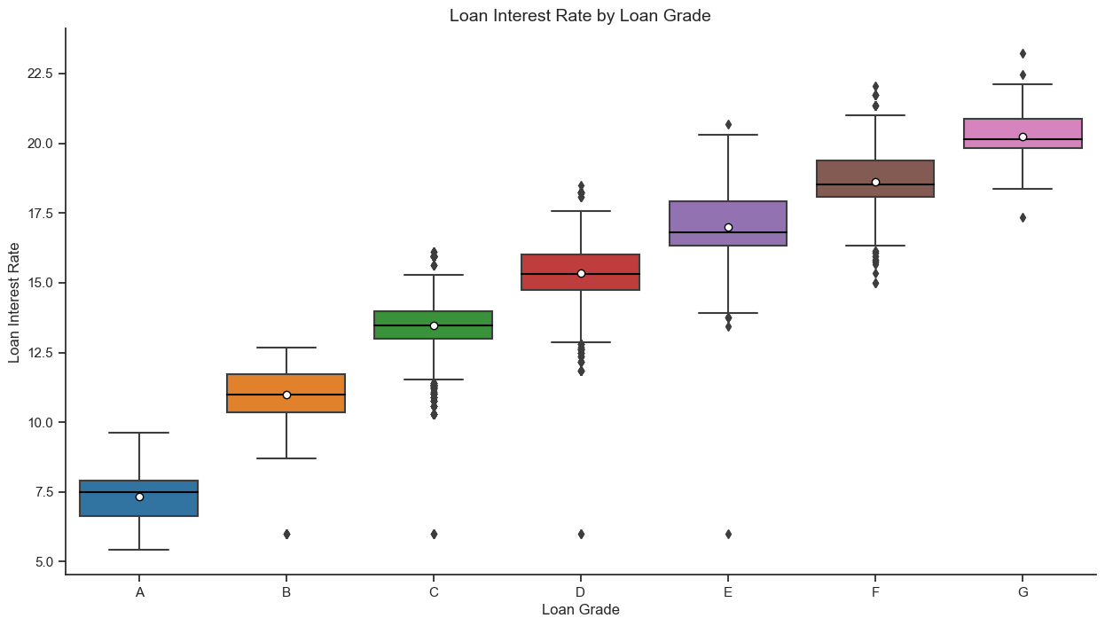
Data Cleaning
Null Values
Variable Name | Total Null
loan_int_rate | 3093
Loan Interest Rate increased as Loan Grade increased
We impute with the median.

Slide 9
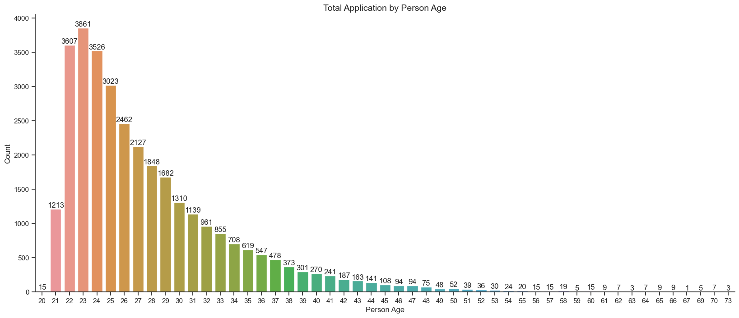
Exploratory Data Analysis

Slide 10
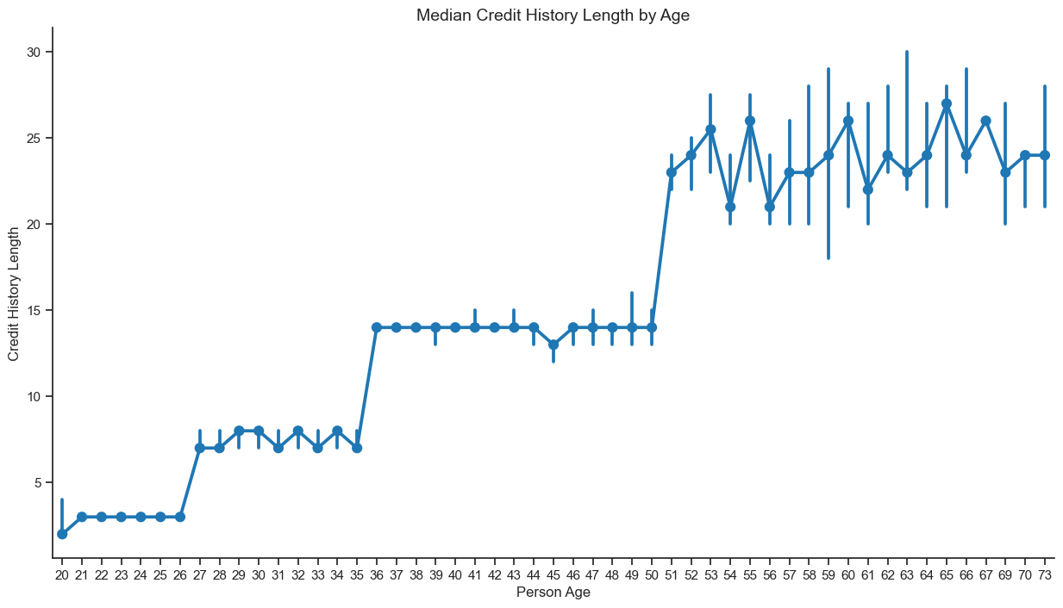
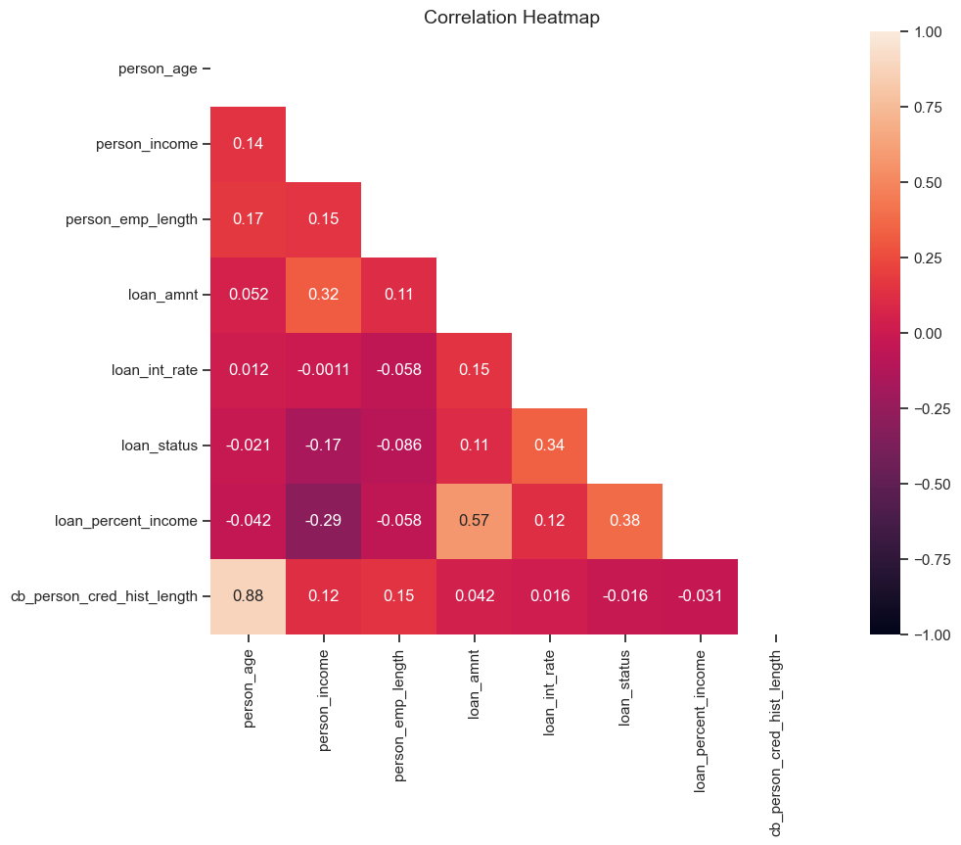
Exploratory Data Analysis
Age and Credit History Length has a linear correlation
We will use age for modeling later

Slide 11
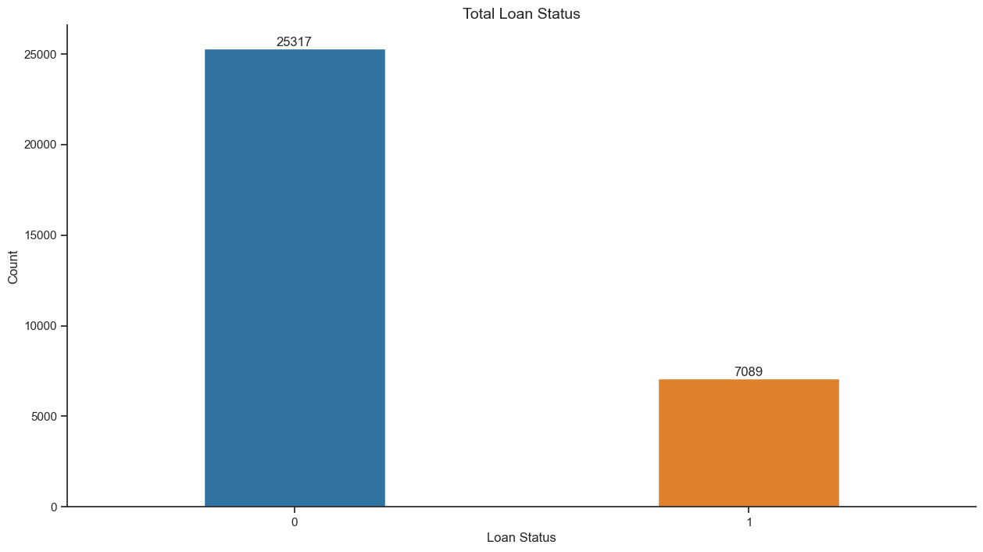
Exploratory Data Analysis
Non-default percentage : 78.12%
Default Percentage : 12.88%
We will have imbalanced classification

Slide 12
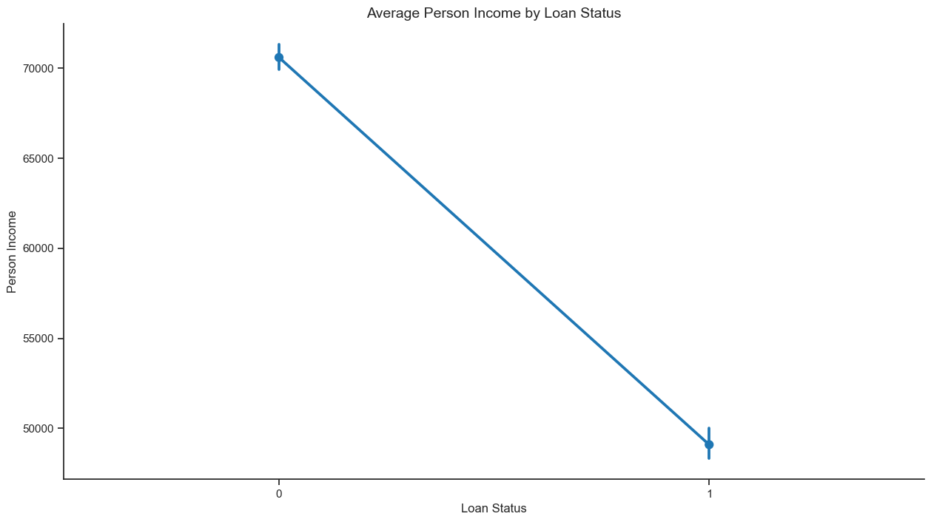
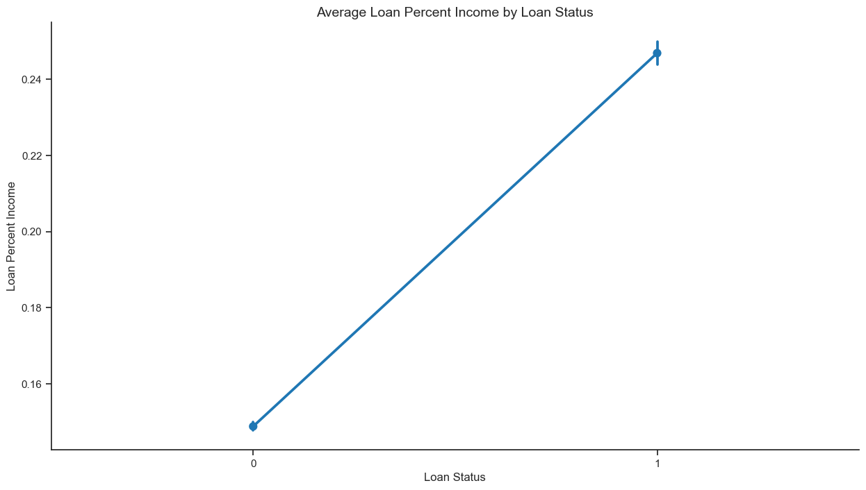
Exploratory Data Analysis
Person with high income and low loan percent income is more likely able to repay

Slide 13
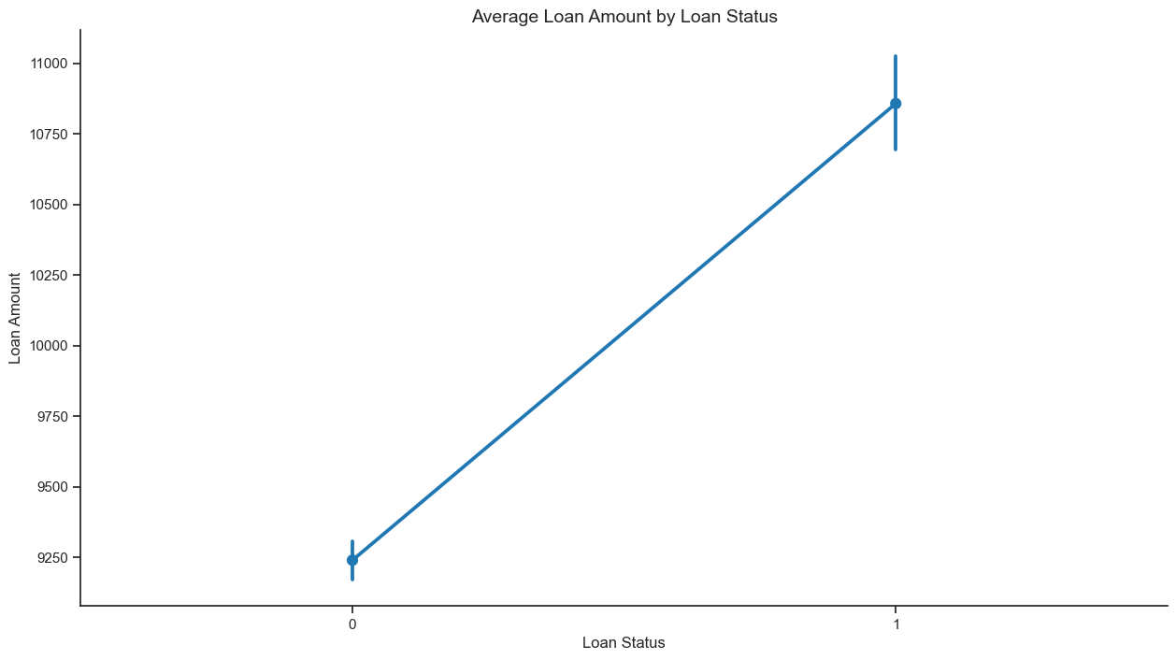
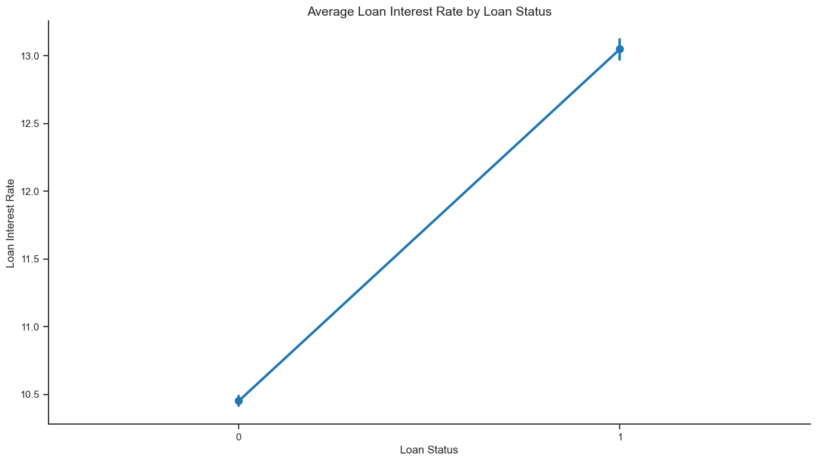
Exploratory Data Analysis
Person with high loan amount and interest rate is more likely unable to repay

Slide 14
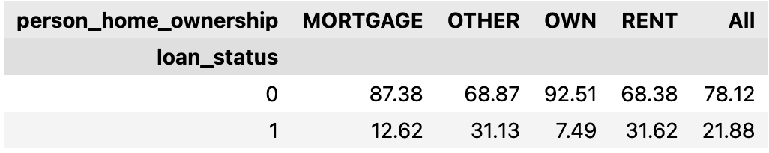
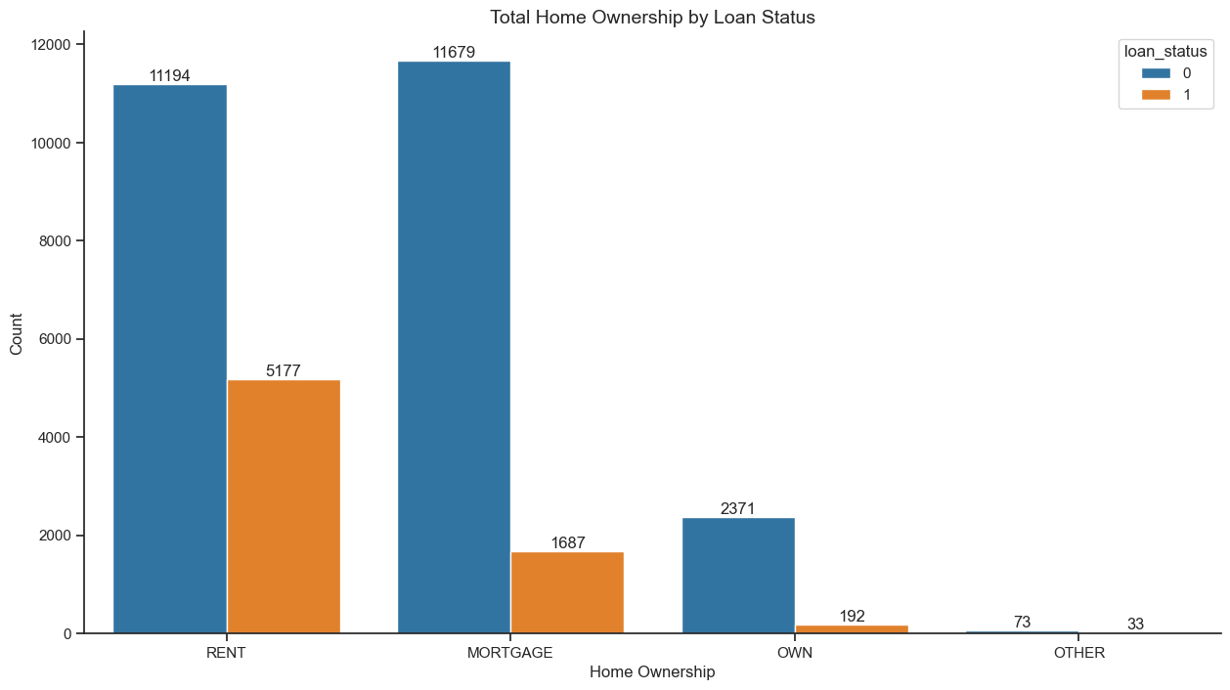
Exploratory Data Analysis
in percent (%)
Person who owns home and mortgage is more likely able to repay

Slide 15
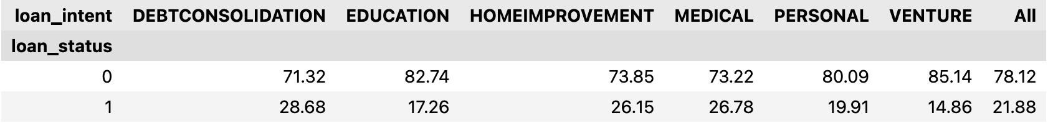
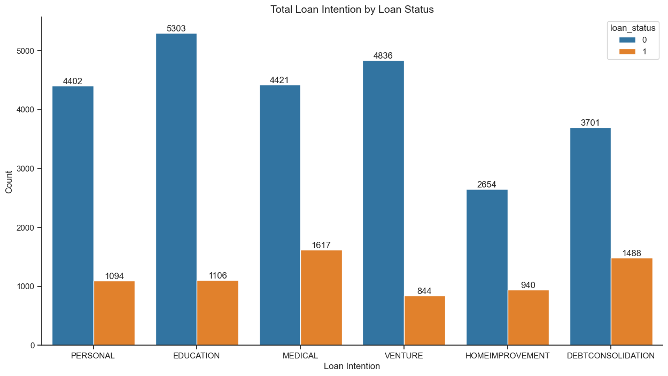
Exploratory Data Analysis
in percent (%)
Person who borrow for venture and education is more likely able to repay.

Slide 16
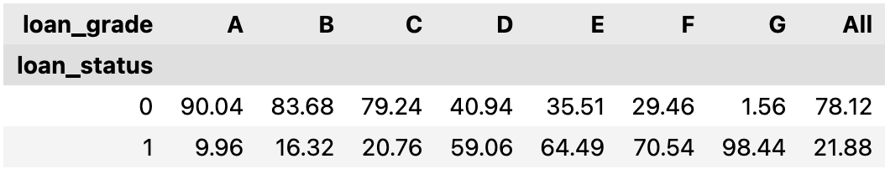
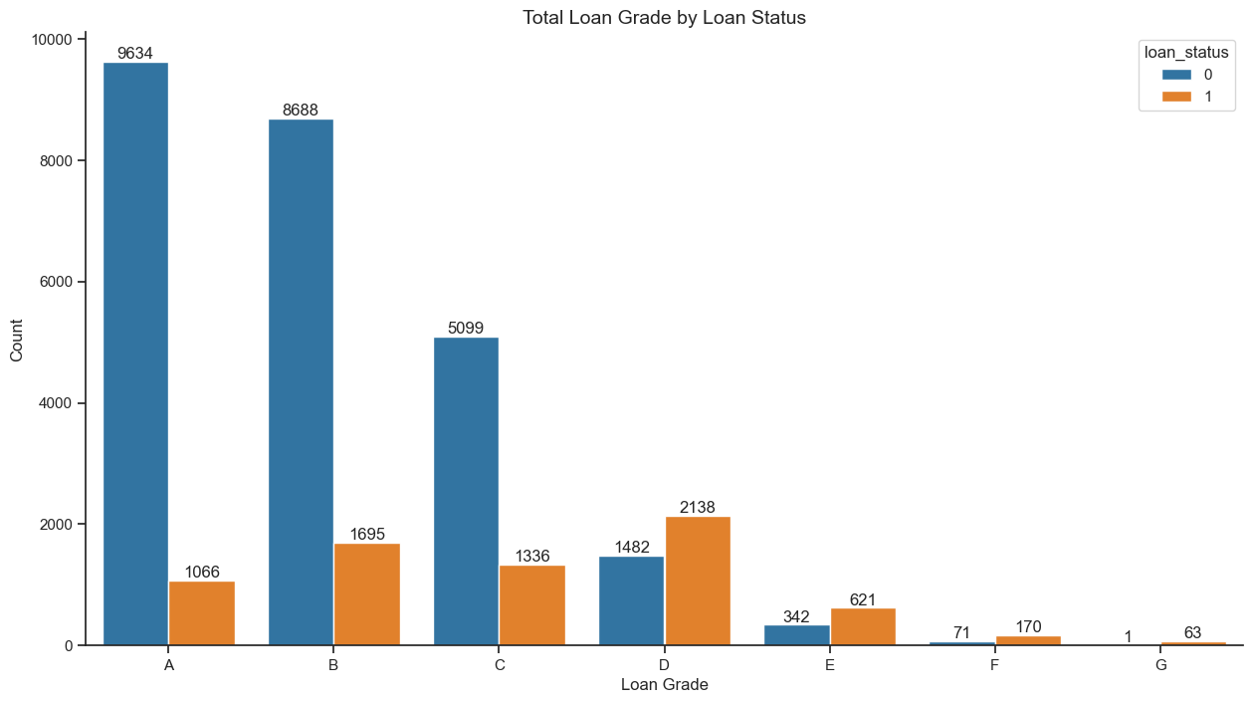
Exploratory Data Analysis
in percent (%)
Person who has low loan grade is more likely able to repay.

Slide 17


Feature Engineering
Target
Transform
To classify one able to repay or not.
Rename target variable to bad_credit
1: Yes/Default
0: No/Non-Default
Drop loan interest rate and credit history length
Scale Numeric Data to (0,1)
Encoding Categorical Data

Slide 18
Modeling
We have imbalanced dataset, therefore we have to choose right metrics
Metrics we consider:
Recall
F1 Score
Reducing bad credit recognized as good credit
Balancing the reduction of bad credit recognized as good credit and vice versa.
Focus on recall will compromise our overall model performance. Therefore, f1-score considered

Slide 19
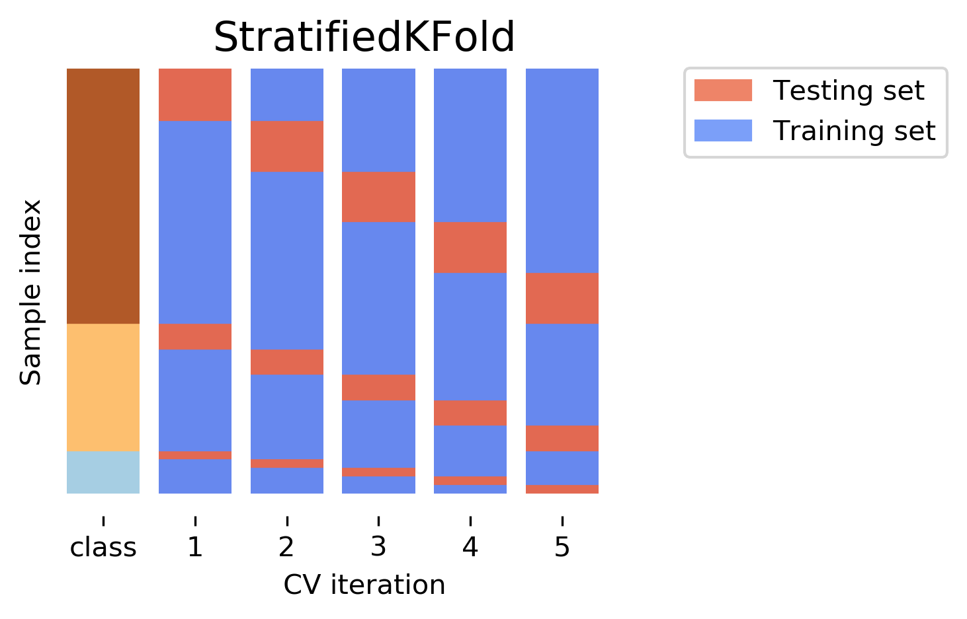
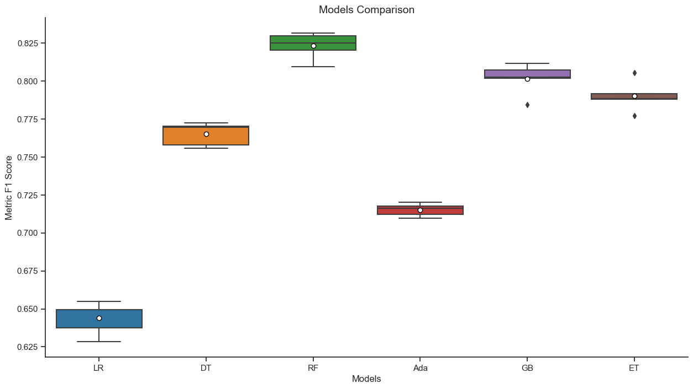
Modeling
Source
Split data train and test by preserving the percentage of samples for each class
Choose randomly one set of them to train and test the model
Check Logistic Regression, Decision Tree, Random Forest, AdaBoost, Gradient Boosting, and Extra Tree performance
Random Forest better than others

Slide 20
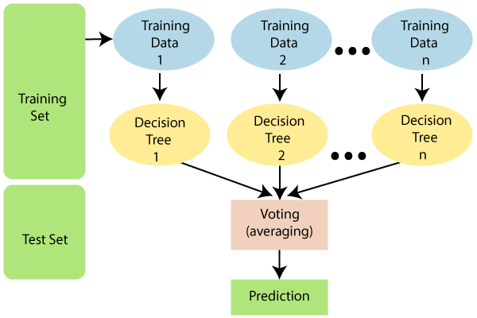
Modeling
Overview Random Forest
Random forest is an ensemble method
Boostrapping training data and make each decision tree
Averaging the predictions across models resulting final prediction
Source

Slide 21
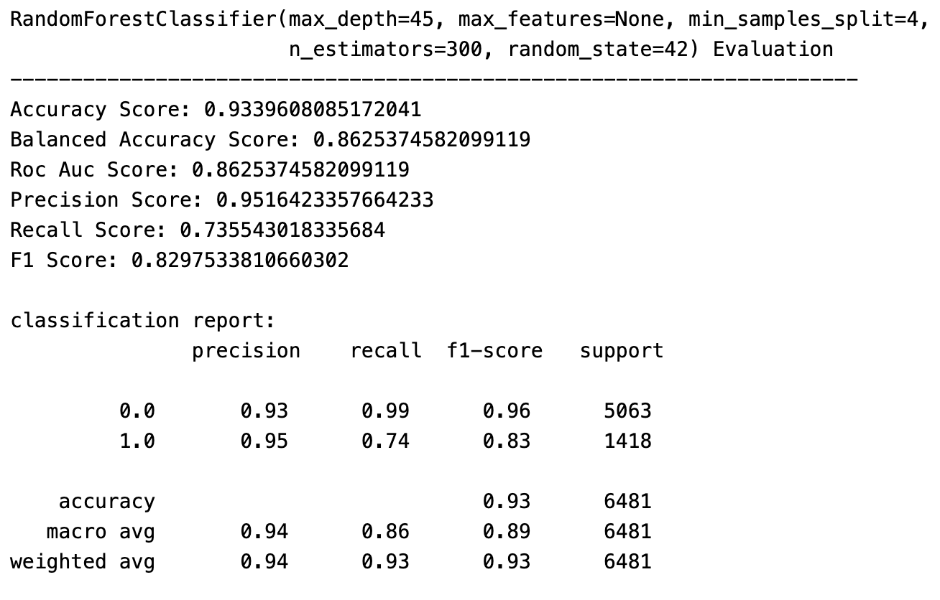
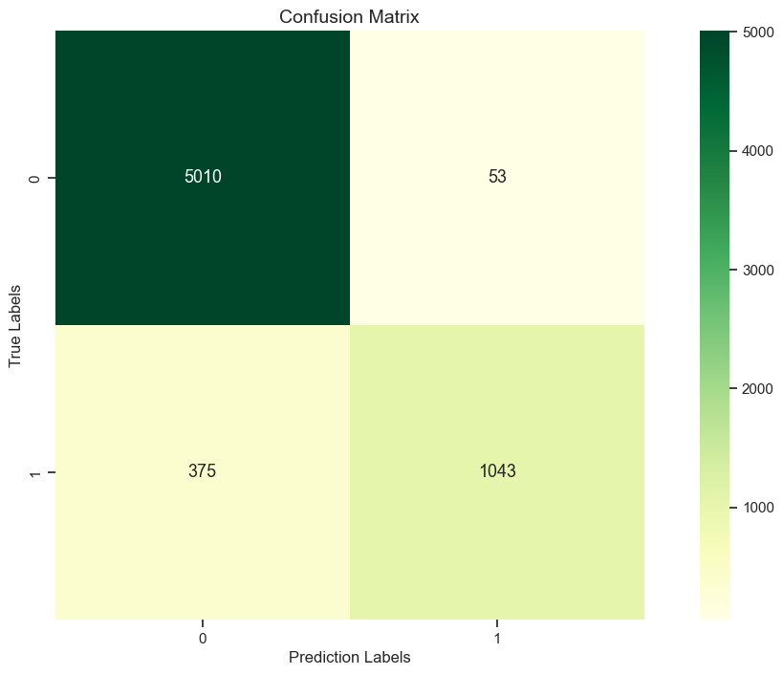
Modeling
Evaluation
F1-Score is 83%

Slide 22
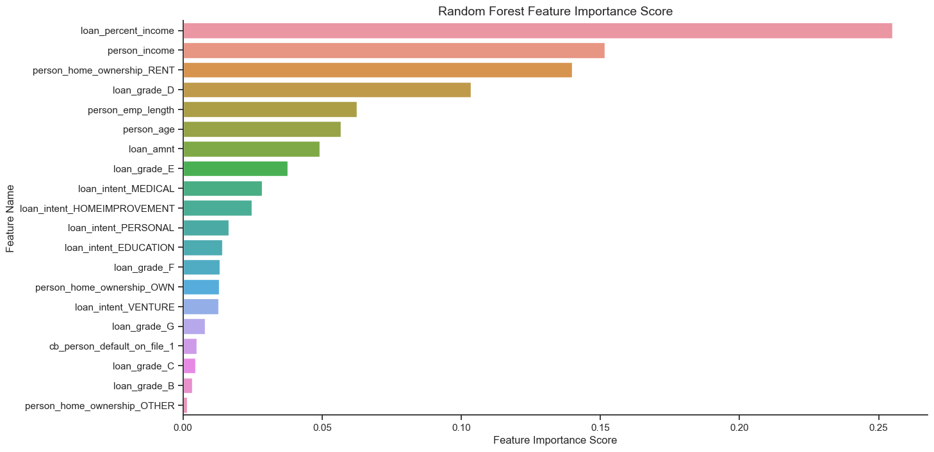
Modeling
Feature Importance
Loan percent income, person income, person home ownership, loan grade, and person employment length are five considered features.

Slide 23



Modeling
Limitations and Trade-Offs
Unable to describe relationships within data
It requires more tree to increase accuracy
Slow because a lot of tree

Slide 24
Modeling
Trade-Offs
Why are resampling data techniques not used to handle imbalanced?
Undersampling → might lose some important information
Oversampling → model tends to overfit

Slide 25
Conclusion
Random Forest predicts application status with f1-score 83%
Top five features considered when providing loans are loan percent income, person income, person home ownership, loan grade, and person employment length.

Slide 26


Thank You
Contact me:
gerendc@gmail.com
gerendchristopher

Slide 27
Credits
The cover has been designed using assets from Freepik.com
The icons have been designed using images from Flaticon.com

